Slide 1


Identical Parallel-Machine
Scheduling with Worker
Assignment to Minimise Makespan
Advanced Algorithms Group Project
Maitha Alawadhi
U25200153 · H1, H2, SA, MILP
Sana Aziz
U25105011 · H3, H4, GA
Dr. Mehdi Jemmali · University of Sharjah · April 2026

Slide 2
OVERVIEW
Agenda
01
02
03
Problem Definition
7 Algorithms
Experimental Setup
P||Cmax-W: jobs, machines, workers
H1-H4 · SA · GA · MILP
500 instances · 3 gap metrics
04
05
Results
Discussion
Cmax, gap tables, head-to-head
Key findings & recommendations

Slide 3
PROBLEM DEFINITION
What Are We Solving?
The Setup
Key Notation
n jobs must be assigned to m identical parallel machines
A total of W workers must be distributed among machines
Processing time depends on worker count assigned to each machine:
n
Number of jobs
m
Number of machines
W
Total workers
p_i(u) = A_i + B_i / (E_i · u)
Ai, Bi, Ei
Job parameters
Objective: minimize Cmax = max machine completion time
Joint decision: job assignment AND worker allocation
NP-hard: exact methods infeasible at scale
Wk
Workers on machine k
Cmax
Makespan (objective)
LB
(1/m)·Σ p_i(W)

Slide 4
METHODOLOGY
7-Algorithm Portfolio
Constructive Heuristics
Metaheuristics & Exact
H1
LPT + RBR
SA
Simulated Annealing
H2
SPT + RBR
GA
Genetic Algorithm
H3
LB-guided (↓) + MFR
MILP
Proven Optimal
H4
LB-guided (↑) + MFR
All algorithms share: same instance representation · compute_makespan() · lower_bound() · is_feasible()

Slide 5
CONSTRUCTIVE HEURISTICS
H1 & H2 Dispatching + RBR
Shared Worker Allocation Rules
RBR: distribute workers proportional to machine load at 1 worker each
MFR: iteratively assign next worker to the most-loaded machine
H1: LPT + RBR
H2: SPT + RBR
Stage 1: sort jobs by p_i(1) DESCENDING (Longest Processing Time)
Assign each job to the least-loaded machine (list scheduling)
Stage 2: apply RBR on the resulting assignment
LPT provides (4/3 - 1/3m) approximation for classic P||Cmax
By loading heavy jobs first, naturally balances machine loads
Stage 1: sort jobs by p_i(1) ASCENDING (Shortest Processing Time)
Same list scheduling assignment as H1
Stage 2: apply RBR on the resulting assignment
SPT is optimal for average flow time on one machine, but poor for makespan
Long jobs pile onto already-loaded machines → imbalance
Serves as a contrast baseline to demonstrate dispatching rule effect

Slide 6
CONSTRUCTIVE HEURISTICS
H3 & H4 LB-Guided Scheduling + MFR
H3 : LB-Guided Decreasing + MFR
H4 : LB-Guided Increasing + MFR
Compute lower bound LB = (1/m)·Σ p_i(W)
Sort jobs DECREASING by p_i(1)
Fill machines sequentially: add jobs as long as load ≤ LB
Move to next machine when LB is reached
Apply MFR for worker allocation
Schedule remaining jobs (RJ) by most-available-machine-first
Identical to H3 with one key difference:
Sort jobs INCREASING by p_i(1) instead of decreasing
SPT ordering with LB constraint, loads short jobs first
Apply MFR for worker allocation
Schedule remaining RJ by most-available-machine-first
Consistently the weakest heuristic, SPT order + LB guide creates poor load balance

Slide 7
METAHEURISTIC
Simulated Annealing (SA)
Neighbourhood Operators
Parameters
①
Job-Move
T0
Auto-calibrated
Move job i to machine k_new → re-apply RBR
T0 = −mean(Δ)/ln(0.80)
α
0.97
Geometric cooling
②
Job-Swap
Tmin
0.001
Exchange jobs i & j on different machines
Stop condition
L
n × m
Inner iterations
③
Worker-Transfer
Budget
5,000 evals
Move 1 worker from machine a to b
Per instance
Init
H1 solution
Starting point
Acceptance: P(accept) = 1 if Δ ≤ 0, else exp(−Δ/T)

Slide 8
METAHEURISTIC & EXACT
Genetic Algorithm & MILP
Genetic Algorithm (GA)
MILP - Exact Formulation
1
Chromosome:
Permutation π (jobs) + worker vector W
Linearize p_i(W_k) by discretizing worker levels: S = W-m+1 levels
Variables: Cmax (continuous) · y[k,s] binary · z[i,k,s] binary
5 constraint groups: job assignment, worker level, linking, budget, load bound
Solved with scipy.optimize.milp → HiGHS backend
mip_rel_gap = 1e-6, no time limit → proven optimality guaranteed
For Family H: 169-313 variables, solves in 1-6s average
Serves as Gap 2 reference for all other algorithms
2
Initialisation:
Mix of H1-seeded + random individuals
3
Selection:
Tournament selection (size q)
4
Crossover:
OX for job permutation + 1-point for workers
5
Mutation:
Swap jobs or transfer one worker
6
Repair:
Enforce Σ Wk = W and Wk ≥ 1
7
Replacement:
Elitist generational replacement

Slide 9
EXPERIMENTAL SETUP
Benchmarking Framework
Instances
Algorithms
Seeds
1,000
7
0–499
500 per configuration
H1 H2 H3 H4 SA GA MILP
Reproducible via numpy RNG
Benchmark Configurations
3 Gap Metrics
I/P/6/3/10
Gap 1:
(Cmax - LB) / LB
vs. theoretical lower bound
n=6 jobs · m=3 machines · W=10 workers
Small : exact solver applicable
Gap 2:
(Cmax − MILP) / MILP
I/P/12/3/10
vs. proven optimum
n=12 jobs · m=3 machines · W=10 workers
Large : challenges exact methods
Gap 3:
(Cmax − Best) / Best
vs. best across all 7 algorithms
All gaps are raw ratios (not ×100)

Slide 10
RESULTS
Summary Results of Both Configurations
I/P/6/3/10
I/P/12/3/10
Alg | Avg Cmax | Gap 1 | Gap 2 | Gap 3
H1 | 114.32 | 0.1273 | 0.0181 | 0.0181
H2 | 130.72 | 0.3035 | 0.1785 | 0.1785
H3 | 139.53 | 0.4097 | 0.2700 | 0.2700
H4 | 160.22 | 0.6029 | 0.4509 | 0.4509
SA | 112.32 | 0.1077 | 0.0000 | 0.0000
GA | 112.33 | 0.1077 | 0.0000 | 0.0000
MILP | 112.32 | 0.1077 | 0.0000 | 0.0000
Alg | Avg Cmax | Gap 1 | Gap 2 | Gap 3
H1 | 212.38 | 0.0537 | 0.0432 | 0.0432
H2 | 232.78 | 0.1593 | 0.1478 | 0.1478
H3 | 233.78 | 0.1634 | 0.1501 | 0.1501
H4 | 268.02 | 0.3379 | 0.3227 | 0.3227
SA | 204.15 | 0.0132 | 0.0031 | 0.0031
GA | 203.80 | 0.0114 | 0.0000 | 0.0000
MILP | 203.52 | 0.0100 | 0.0000 | 0.0000
★ Green values = Gap 2 = 0 (matches proven optimum) · Best Cmax highlighted in teal

Slide 11
RESULT HIGHLIGHTS
Performance at a Glance
99.6%
0.31%
37×
SA matches MILP
exactly on n=6
SA avg Gap 2
on n=12
SA faster than MILP
(0.17s vs 5.55s)
100%
H1 > H2
7 algs
SA beats H1
on I/P/6/3/10
LPT beats SPT
in 93% matchups
All benchmarked on
1,000 instances

Slide 12
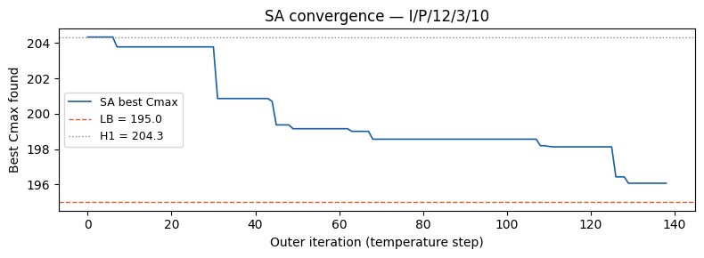
RESULTS of SA CONVERGENCE
SA Convergence on I/P/12/3/10 Seed=5
Key Observations
· H1 starts at 204.34 (Gap 2 = 4.8%)
· Rapid drop in first 40 steps
· Plateau ~iter 80-120 → local optimum
· Final jump to 196.08
· Gap 2 = 0.55% vs MILP optimum (195.98)
· Staircase = SA escaping local optima

Slide 13
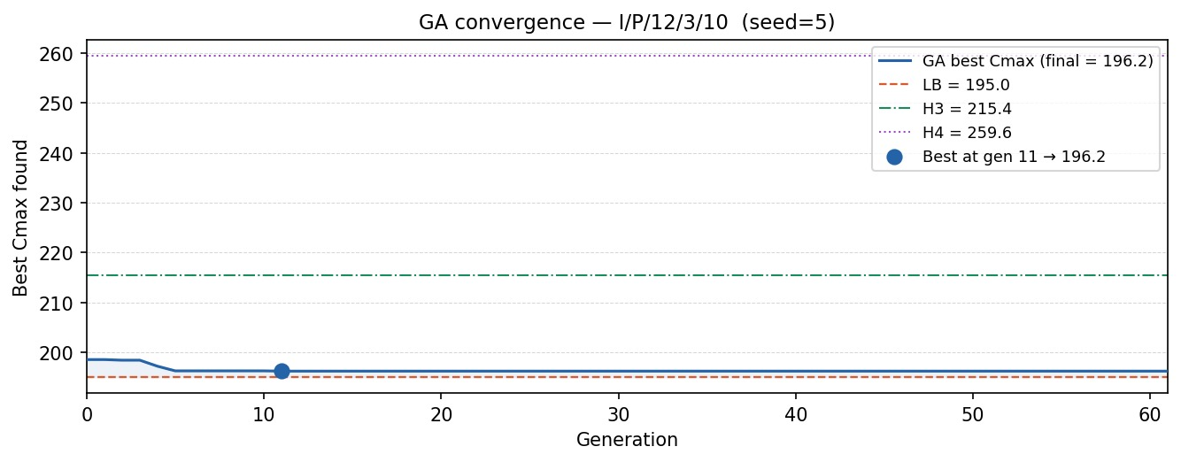
RESULTS of GA CONVERGENCE
GA Convergence on I/P/12/3/10 Seed=5
Best Cmax = 196.2 found at generation 11 (LB = 195.0).
No improvement after gen 11; stall at gen 61.
Final gap: 0.62% above LB, beating H3 (215.4) & H4 (259.6).
Rapid convergence vs. SA’s gradual steps.
OX crossover on job permutations successfully escapes greedy construction limits.
Key Observations

Slide 14
RESULTS of WORKER ALLOCATION
How Workers Are Distributed
Key Insights
H1 & H2 via RBR
Near-uniform distribution
[3,3,4] most common (78%)
Std ≈ 0.9 per machine
SA & MILP
High variance : std ~2.7–3.2
Unconventional like [1,1,8]
Instance-specific optimisation
Why it matters
RBR ignores worker sensitivity (Bi)
SA/MILP find targeted allocations
This is why SA beats H1 by ~4%

Slide 15
RESULTS of HEAD-TO-HEAD
Direct Pairwise Comparisons
100%
SA beats H1 on n=6
93%
H1 beats H2
98/500
SA ties MILP on n=6
0.63
Avg units MILP beats SA
on n=12 Cmax
Note: win = strictly lower Cmax. Ties counted separately.

Slide 16
DISCUSSION
Key Findings & Limitations
LPT > SPT
SA & GA near-optimal
H1 consistently outperforms H2, H3, H4. Dispatching rule selection is the dominant factor in constructive heuristic quality.
SA matches MILP on 99.6% of small instances. GA achieves Gap 2 = 0 on large instances. Both far exceed constructive heuristics.
01
02
Worker allocation critical
LB is a weak metric
RBR's proportional logic is suboptimal when job worker-sensitivity varies. SA/GA discover targeted allocations RBR cannot produce.
Gap 1 values of 10% for MILP on n=6 are artefacts of the relaxation. Gap 2 (vs. MILP optimum) is the correct quality measure.
03
04
⚠ Limitation: benchmark restricted to m=3, W=10, n∈{6,12}. Performance on larger instances unknown.

Slide 17
Conclusion
✓
Seven algorithms
benchmarked on 1,000 instances with 3 gap metrics
✓
SA is the practical champion:
near-optimal in real time, 37× faster than MILP
✓
GA achieves Gap 2 = 0
on large instances, strongest solution quality overall
✓
H1 best constructive heuristic:
LPT dispatching clearly outperforms SPT-based variants
✓
MILP validates everything:
proven optimality used as the Gap 2 reference
Maitha Alawadhi · Sana Aziz | Advanced Algorithms | University of Sharjah | April 2026

